Slide 1
Strengthen & Adapt Project Draft Summary
November 2023
Strengthen & Adapt Project
Summary Key Findings
Connecting the equestrian system for a horse and human centred future.
Final Report: November 2023

Slide 2
Background to Strengthen & Adapt
The NZ Strengthen and Adapt project is a government response to COVID-19 to provide sports organisations and networks with the opportunity to strengthen their capability and capacity, post-pandemic, and create a better future for those who take part. It has been rolled out across New Zealand to cover many sport codes including Equestrian Sports.
In recognition that the Equestrian landscape is very broad in New Zealand, with a huge number of New Zealanders connecting with horses at some stage in their lives, and the lucky ones getting to explore the sport further, the aim was to consult with as many people as possible, both members and non-members of Equestrian Sport New Zealand.
Phase One of Strengthen & Adapt included a survey in September 2022, with 1,600 responses.
Phase Two included 22 in-person consultation workshops ( our roadshows ), and 2 online workshops.
Phase One identified a series of themes that our Equestrian Community wished us to ‘keep’, ‘stop’ and ‘start’.
Final Report: November 2023

Slide 3
Phase One: Keep, Stop, Start Themes
KEEP
provision of competitions and events
encouraging participation for all
listening to and communicating with participants
providing services and support to members and organisations
providing training & education
promoting horse welfare
START
create approaches that support grassroots participation
design membership & competition fee approaches that provide value for money
make competition offerings & pathways more inclusive of all levels
be more inclusive & supportive of diversity
provide education offerings & pathways
develop user-friendly information-sharing tools
foster a healthy equestrian community culture.
STOP
raising costs
not addressing the poor culture and behaviours
organisational inefficiency or ineffectiveness
over-complicating rules
enabling elitism
condoning bad behaviours that affect horse welfare
Final Report: November 2023

Slide 4
Roadshow Methodology
During Phase Two our workshops connected 336 people across 21 locations and two online sessions. Workshops were held in the following locations: Northland, Auckland (Albany and Clevedon), Waikato (Taupo and Cambridge), Bay of Plenty (Tauranga), Hawkes Bay (Waipukuruau and Havelock), Gisborne, Wellington (Otaki and Hutt Valley), Taranaki (New Plymouth and Hawera), Nelson, Marlborough, Canterbury, Southland (Gore and Dunedin), Greymouth.
Workshops provided the opportunity for an independent facilitated conversation and were hosted by Michelle Hollands, Freshminds Consultancy Limited. We were deliberate in our decision to employ the services of an independent consultant to ensure that any unconscious bias by our internal team was removed, providing for the opportunity to hear the voices of our community and truly listen to their feedback.
All workshops followed the same format including establishment of Personas, Regional rankings, key themes (celebrations and challenges) and ideas/concepts for the future.
A note from Freshminds Limited:
Thank you for the opportunity to work with the team at Equestrian Sport New Zealand and the Equestrian community across New Zealand. The information summaries in this report provides a high-level summary of feedback provided from participants. This report should not be considered strategic or investment advice, rather a summation of feedback received across the workshops completed. Prioritisation and investment decisions remain the responsibility of ESNZ senior management and the Board of ESNZ.
Final Report: November 2023

Slide 5
The Horses and Humans Identified
In any improvement project, such as Strengthen & Adapt, it is important to understand ‘why’ change is needed and ‘who’ any change is established for.
Across our workshop series we asked participants to develop personas. To describe for us ‘someone they know who would like to be more involved in Equestrian sports’.
The following personas are a summary of the most common people described. Our ‘personas of change’ start with the horse and human who simply ‘would like to do more’.
We note these are not real people, but they should resonate with the people in our community and perhaps even make you think of someone you know.
Final Report: November 2023

Slide 6
Makayla Macintosh
Age 12:
Makayla has an undeniable passion for horses, she spends her free time reading books about horses and visiting the local horse Harvey to feed him grass and left over fruit from her home. She dreams of riding one day but comes from a family with no background in horse riding.
Makayla lives in the city with her mum, dad and two older sisters who all live very busy lives with work, school and sport. Despite not even having ridden a horse yet, Makayla dreams of one day living on a farm and having her own horse. She really wants her parents to take her riding and to buy her a horse. Her challenge is getting access to a horse that she can ride and compete with, if she is allowed. Her parents could support her to do this but have lots of safety concerns. There is no connection from any equestrian sports organisation at her local school and she only knows a few girls at school who currently ride horses, they’re not her immediate friends.
To enable Makayla to ride she needs:
Access to a horse to ride
Support information for her parents to understand how she will safely learn to ride and care for a horse
A community of people willing to support her to ride and to help her to compete
Someone to support her non-riding family to learn more about horse riding
Final Report: November 2023
Strength & Adapt Project Overview

Slide 7
Sarah Jones
Age 41:
Sarah has been involved in horse riding most of her life, first it was Pony Club, then Show Jumping. From a horsing family Sarah left New Zealand for her OE, stopping riding while she was there and only returning to have a family.
Sarah now lives in the rural Canterbury town of Leeston with her husband and two children, Tom aged 4 and Jessica aged 2. Despite having ridden all her life Sarah has no idea how to get back into the sport. She has lost touch with most of her equestrian friends, now doesn’t own a horse but has the means to buy one, and probably most importantly Sarah has lost her riding confidence. She’s nervous about hurting herself or making a fool of herself. She’s unsure about what rules may have changed and having pulled out the small amount of riding gear she still owns she’s realised it’s looking pretty old and is perhaps not at all modern enough to support her return to riding.
To enable Sarah to ride she needs:
A welcoming environment to encourage her to return.
Support information to understand where the best opportunities to ride are to support her capability and enable her to move past her fear of riding.
Access to a horse and equipment
A community that will support her in returning to riding with a young family, perhaps even over time encourage their involvement.
Events and opportunities that enable her to be the best she can be – coaching, mentoring, lower heights and fun family environments.
Final Report: November 2023
Strength & Adapt Project Overview

Slide 8
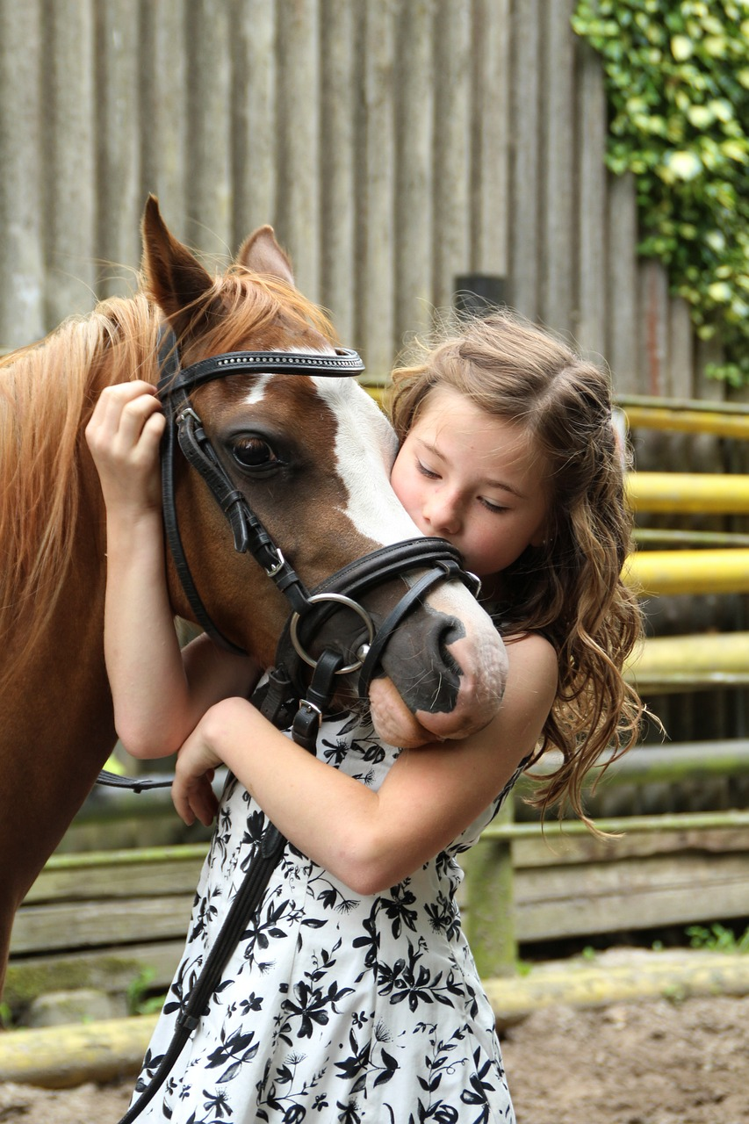
Vic and Steven Bernard
Age 42 and 46:
Vic and Steven are new to the Equestrian world, in fact Steven has always had a checkered history with horses, he has mild allergies and a fear of getting kicked. They’ve become involved in the sport because Maeve, one of their three daughters, had a passion for Pony Club and without being biased ‘she’s actually quite good’ and has recently moved into Show Jumping events.
Vic and Steven are doing everything they can to support Maeve’s growing enthusiasm. They’re lucky, they’ve been able to find a horse and riding equipment that they can afford, they’ve brought a small horse float and where they can they transport Maeve to shows to compete and learn. It’s year three for Vic and Steven, and while their confidence is growing, they’ve certainly got a long way to go. In sharing their experiences, they note “We’ve been yelled out for entering the ring the wrong way round, we’ve had the horse get loose in the parking area, we generally struggle with all the rules, and we really don’t like asking anyone for fear of looking silly. We’ve shown up to events and not entered correctly, we find the event entry system and membership model complex”.
To help Vic and Steven we need to consider:
Simplifying the membership and event entry models.
Clear and simple rule definitions.
Courses in event competition preparation and horse care.
Opportunities for mentors for Maeve and themselves.
Clear pathways that showcase for them how Maeve can progress.
Final Report: November 2023
Strength & Adapt Project Overview

Slide 9
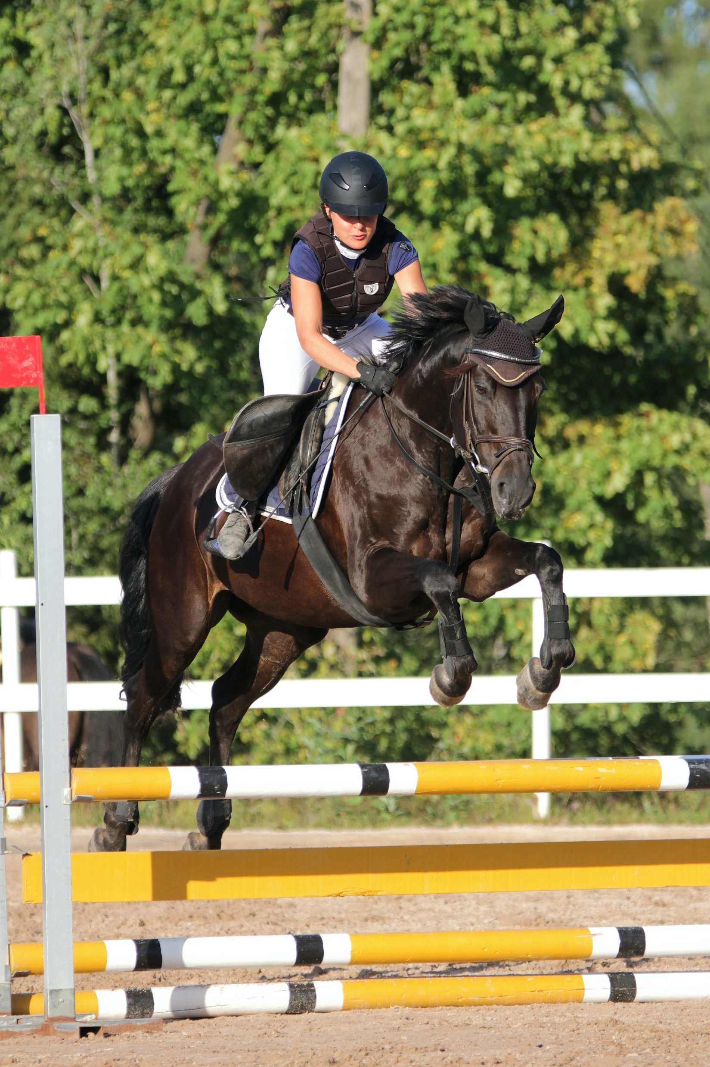
Joanie Surrento
Age 43:
An amateur level competitive rider, Joanie has been riding since she was a child. She went through the levels at Pony Club including representing her region in a team at Pony Club champs in the 80s.
Joanie predominantly enjoys eventing, but also dabbles in dressage and show jumping. Joanie is a middle-income earner and pours much of her income into her horses and riding. She organises clinics in partnership with a past professional rider and does some lower-level coaching outside of her full-time job to fund her competitive riding. Joanie has created a social media following to gain sponsorship to help enable her to afford to compete.
She finds it very expensive to compete in eventing especially as she moves up the levels and although she needs mileage in the show jumping arena it is fast becoming unachievable to pay the discipline starts (for multiple disciplines) to gain this much needed competition mileage in a discipline second to eventing.
To help Joanie we need to consider :
Ways for the amateur rider to move between disciplines with some affordability.
Access to FEI events whilst maintaining a full-time job (difficult to do if arrival inspections are during the week, particularly if these are early in the day).
Ensuring costs and fees don’t escalate beyond affordability for a non-professional rider.
Final Report: November 2023
Strength & Adapt Project Overview

Slide 10
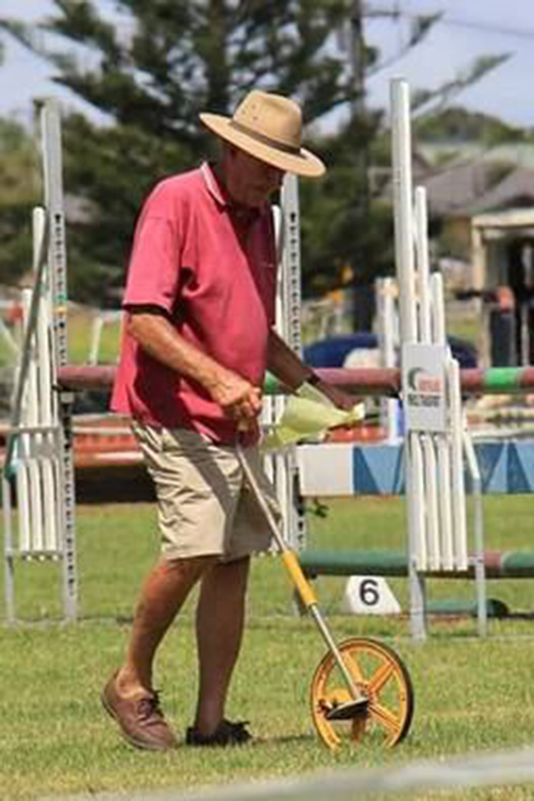
Pete and Jess
Age 60 and 34:
Pete has been volunteering as a member of the Organising Committee for the past 15 years, he’s well-loved in the eventing community and is the go-to for all things showjumping. Over the time he has volunteered Pete has done everything and anything to ensure that the sport thrives and that riders have a great time. He worries about the future delivery of the sport but also doesn’t understand the desire to utilise social media and is frustrated by the complicated membership models, technology used for membership and the increasing number of rules.
Jess is a relative newcomer to the eventing world. Her daughter has recently started riding and she absolutely loves the sport. She wants to be involved in a voluntary capacity but really doesn’t know where to start. She’s nervous she will get things wrong and really has no idea where to start.
To help Pete and Jess we need to consider :
Plans to support Pete to learn new ways of working but also to support him to retire from his voluntary work. To provide him the opportunity to have confidence in handing over the reins to someone new.
Resources and guides to provide Jess with a clear understanding of what a voluntary role may be. Procedures to support her understanding what to do and when things need to be done.
Mentoring and coaching both for Pete and Jess to support their transition.
Final Report: November 2023
Strength & Adapt Project Overview

Slide 11
Celebrations
Across our workshops participants were asked to list the things they celebrate about delivery in the environment in which they participate and compete. Key themes identified included:
Community - Strong sense of community, inclusive and friendly
Collaboration - Evidence of working together to support and welcome riders of all disciplines and all capabilities
Events - Access to quality events of all disciplines for all riding levels, multi-discipline events support community engagements, many options for other equestrian competitions (some areas - especially those with facilities), affordable opportunities to compete, year round events within a reasonable and affordable driving distance, events at all heights and all levels.
Pony Clubs – are good in the area and play an important role in nurturing young riders, a growing number of ribbon days and opportunities for young riders.
Cost - is considered to ensure entry fees and event participation is affordable
Volunteers - a strong and enthusiastic group of volunteers, large committees that are willing to work together
Support for Riders - there is availability of good education and skill development for riders through clinics, pony clubs, riding groups, and various coaching opportunities, opportunities for riders to have access to horses (e.g., for RDA transition), provision of pathways and support, opportunities for education and development
Membership – grassroots option to encourage joining
Coaches - encouragement for upper-level coaches to visit the area, access to quality instructors and coaches, support for coaches wishing to develop their skills
Facilities - diverse range of safe riding environments available, multi-discipline hubs support multi-discipline events
Horse Welfare - a positive emphasis on horse welfare
Culture - encouraging and supportive, learning from one another as newcomers join the sport
Funding and grants – support participation and provision of events
Connections - exist with schools to extend invitations to young people who are interested in equestrian sports.
Final Report: November 2023

Slide 12
Challenges
In addition to the celebrations, participants identified the following key challenge themes, in many cases the celebrations (where one region or discipline celebrated success) were the same as the challenges another faced:
Events - limited one day events, conflicting schedules and a need for better coordination, limited Show Jumping Heights, management becoming increasingly difficult especially increasingly Health and Safety, limited access to recreational riding opportunities, lack of access to year-round events (some areas), need to improve administration efficiency of event management - ESNZ support, cost of delivery
Facilities - limited all-weather appropriate surfaces for adverse weather (some areas), limited parking in some areas, lack of access/variety of access to bridleways, beaches and roadside, safe access - especially roadside, lack of visible national advocacy for access, need to strengthen connection to cycling and walking for trails
Coaching - limited access to quality coaches (especially performance coaches) in some areas, lack of pathway/career options for coaching profession
Culture - sometimes negative and uninviting, anxiety and fear or lack of confidence a challenge for new riders, not always a sense of community belonging
Volunteers and Officials - burn out - especially with event frequency, ageing workforce, lack of volunteers, fear for volunteers of getting it wrong
Riders - horse availability - for adults and children who are not owners, rules and regulations are complicated, safety requirements are increasing costs, lack of adult riding clubs/groups (some areas), lack of clear pathway (some areas), a need to bridge the gap between Pony Club and ESNZ competitions, support for Youth and new riders
Communications - limited marketing and celebration of athletes and a lack of positive storytelling / communications, need to share the benefits of horse related activities for wellbeing and health
Professionals - shortage of skilled professionals for equine sports (especially smaller remote areas), shortage of farriers, physio's, saddle fiters vets etc
Cost/Funding - increasing cost of fuel - distance to travel, hard to access funding - time consuming sponsorship and grant applications for little return, cost of entry and membership, increasing cost of equipment and gear, cost of living
Membership and Registration System – complicated, expensive
Rules – complex, difficult to find/understand
Lack of Collaboration - need for disciplines to work together, lack of network for sharing ideas across areas
Public Perceptions - impact of sport not always seen as positive for the horse (right to ride), seen as elitist and for wealthy

Slide 13
Delivering Change
Ideas and concepts identified to support change have been grouped into three themes. These themes have a number of actions or initiatives that will need further definition and prioritisation by the Equestrian Community and ESNZ Management and Board:
One Equestrian Voice :
Initiatives to improve leadership structures, connections and presence
Establishment of a cross discipline national leadership group to :
Assess the potential to bring Equestrian Sports together and the options to improve existing structures.
Improve collaboration between ESNZ and Pony Club.
Advocate for and support important concepts:
Social licence ‘right to ride’ and animal welfare.
Facilities – access and quality of all facilities (multi-use, indoor arena’s, bridleways, roadside riding),
Funding and Sponsorship – establishment of models to support local applications and initiatives that enable community funding; guidance and national training programmes/workshops to support local sponsorship/funding success,
Cost reduction initiatives (joint procurement) – insurance, first aid, health and safety.
Regional establishment of cross-discipline committees to:
Share knowledge and resources and deliver multi-discipline events
Advocate for important regional and local concepts including facility development, safe access to riding spaces, funding and sponsorship
Final Report: November 2023

Slide 14
Delivering Change
Supporting Riders to Ride
Initiatives to enable participation, competition and access to quality riding experiences
Review of Membership Model with a focus on – simplification, flexibility and value. Options include:
First year free, membership holidays, multi-discipline membership, discounted event entry models (enter 4 get the 5th free), rural membership, student discount, increase to the adult age (18 years), national approach to flexi starts, community membership (not competitive riders).
Delivery of Events that enhance the opportunity to ride. Options include:
Multi-discipline events calendar,
Improved event entry software and support line for entry,
Lower heights (including cross country),
Fun and introductory activities – give it a go days,
Adult and child events - family based day out,
Recreational riding events and activities (lower heights, less competitive).
Review of the Rules – assessment of rules ‘adding value’ or ‘adding cost/complexity’.
Development of a Rider Resource: Introductory handbook for new riders (all disciplines):
Simplify entry requirements,
Overview of rules,
Online workshops on how events run.
Sharing Riding Resources and the creation of platforms to enable this conversation (i.e. social media):
Connecting riders with horses (for those who do not have a horse),
Pay it forward or second-hand equipment sale.
Final Report: November 2023

Slide 15
Delivering Change
Strengthening the System
Promoting positive attitudes/inclusive culture: Change The Rein plus other concepts
Nationally Coordinated Volunteer Support including:
Succession planning,
Recruitment resources (Job Descriptions),
Training programmes,
Celebration and recognition of volunteers.
Coach Development – establishment and delivery of national training and resourcing including:
Coach Qualifications
Mentoring
Coach Development
Coaching clinics parallel to Riding Clinics
Rider Development:
National Certificate in Equine Care
Pathway provision and delivery of planned national/regional/local rider development programmes – RDA to Para, Grassroots to ESNZ
Coordinated Coaching Clinic Calendar (ensuring availability of quality coaches nationwide)
Website Improvement:
Contacts Database,
Multi-discipline Events Calendar – regional and national to avoid clashes.
Officials Development – establishment and delivery of a national training programme and pathway:
Establishment of a Course Builder Network – to share knowledge and plan for events.
Establishment of an Allied Health Service Network – to create sufficient provision, share contacts and plan health events.
Event Management Guide / Handbook – to enable quality events and ease the load on volunteers.
Communications Network – to share knowledge, learnings, grow professionalism of all communications.
Social License Communications Programme

Slide 16
What’s Next?
By middle of Nov complete the last 2 face to face and 2 online sessions
1
Review all insights and feedback and complete summary documentation.
2
Organise time with discipline boards to discuss and decide what is important to them
3
Review meeting with S&A Steering group
4
Send the themes to all that attended the roadshow to get feedback in terms of prioritisation
5
Collate and present to ESNZ board for final discussion on the themes we will develop
6
Set up working groups around those themes to co design the work
7
Final Report: November 2023

Slide 17
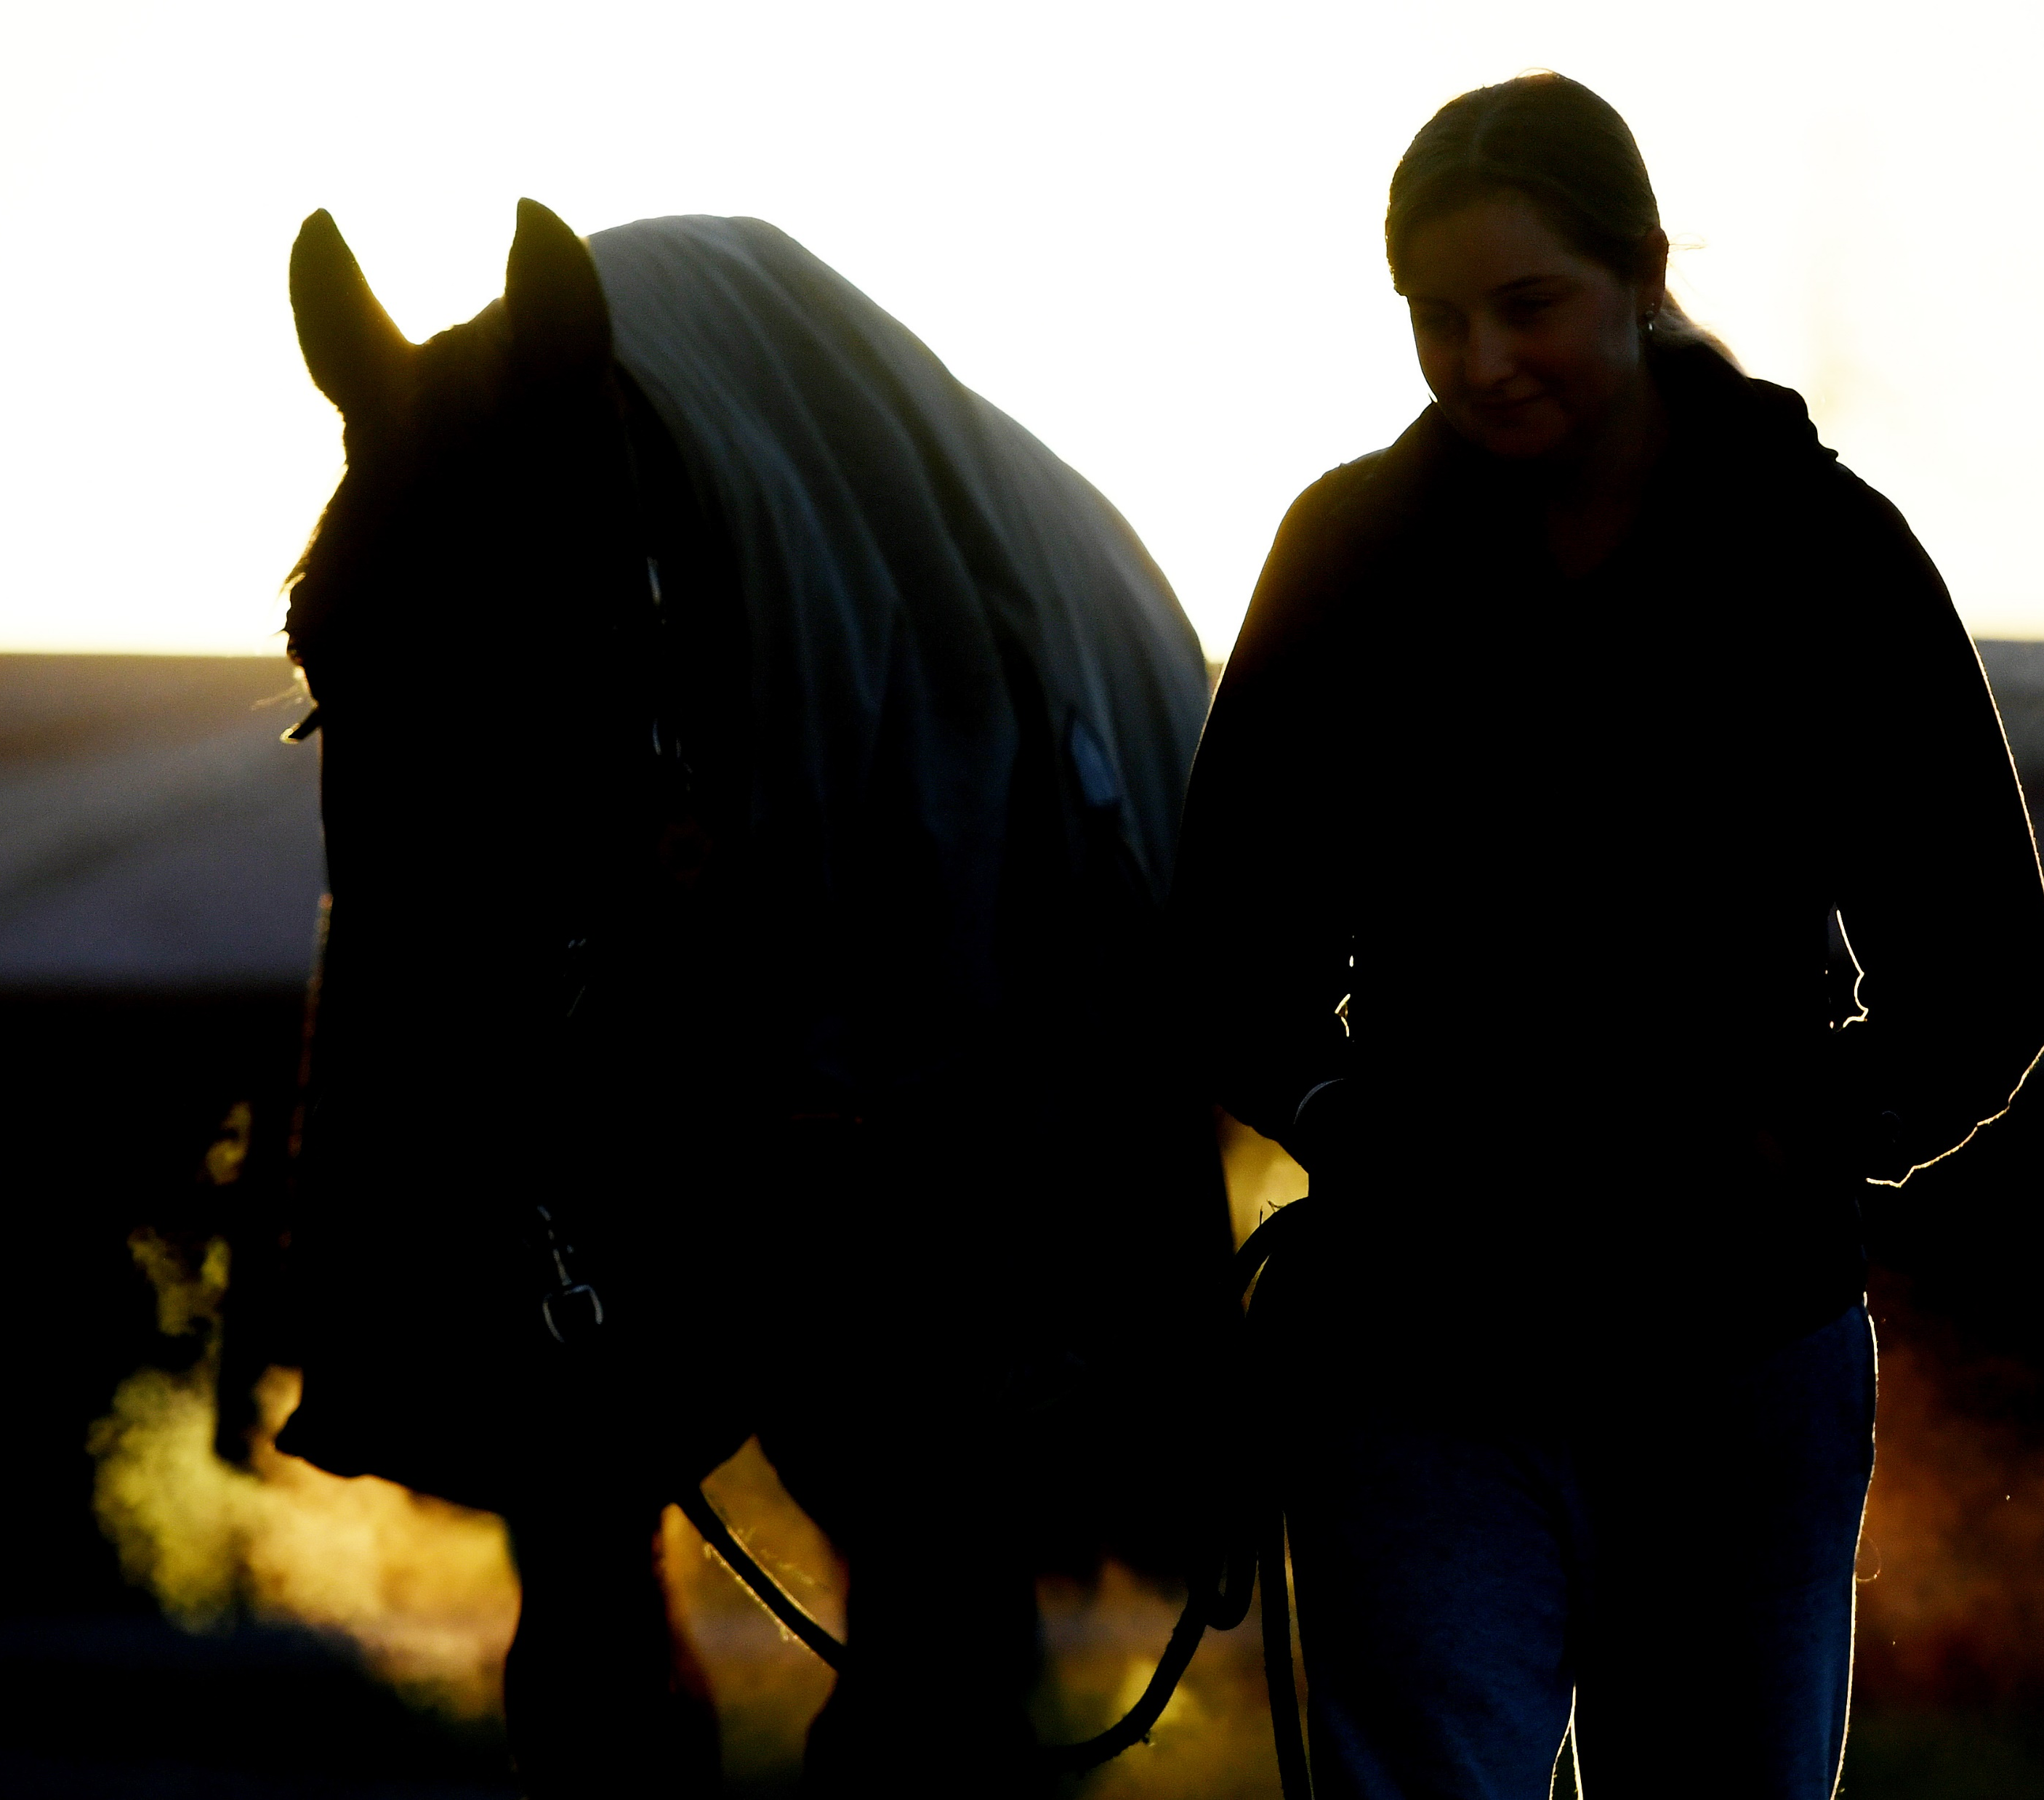
“To quote Winston Churchill, ‘There is something about the outside of a horse that is good for the inside of a man’”

